Slide 1
CONCRETE STRENGTH PREDICTION
ML_PROJECT_MASAI
(GROUP 11)

Slide 2
GROUP MEMBERS
BHOORI SINGH
HARI KRISHNA
PRATHAM KATARIA
SUKRUT DESHMUKH

Slide 3
OBJECTIVES
Exploring the key features of Concrete Dataset.
Preparing & Analysing the data for building up the models.
Training & Testing the data for different models.
Checking and comparing different evaluation metrics of the models.
Finding out the best model for the dataset.

Slide 4
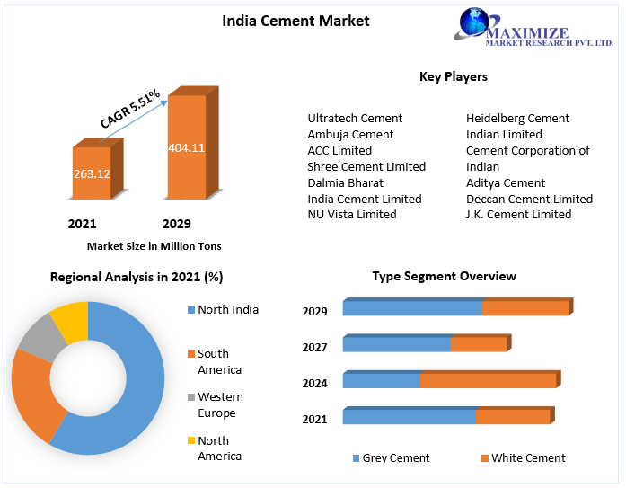
INFORMATION RELATED TO DATA
Concrete is a composite material composed of fine and coarse aggregate bonded together with a fluid cement (cement paste) that hardens (cures) over time.
Cement is one of the main components for preparing Concrete.Contributing around 22% in composition of Concrete.
India is the second-largest producer of cement in the world, accounting for more than 7% of the global installed capacity. In FY 2022, domestic production of cement stood at 356 million tons, up from 296 million tons in FY 2021.

Slide 5
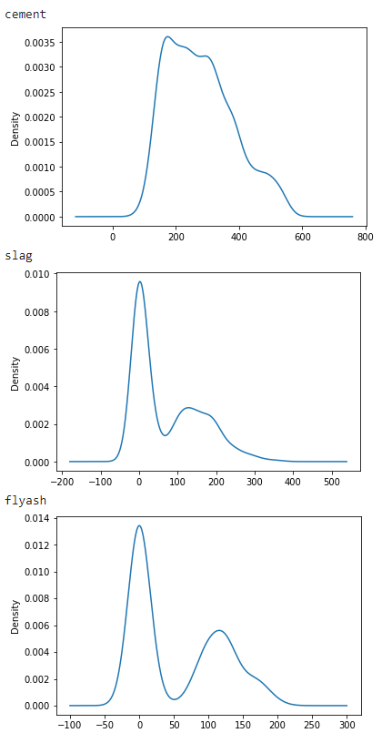
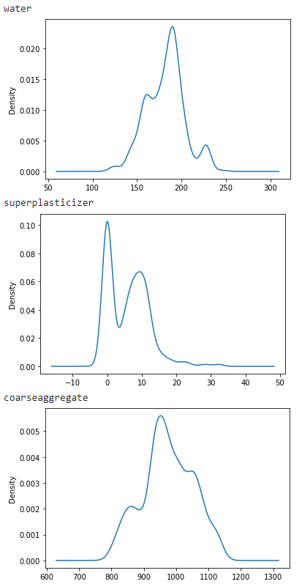
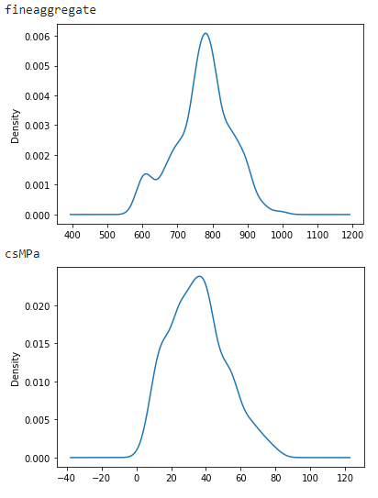
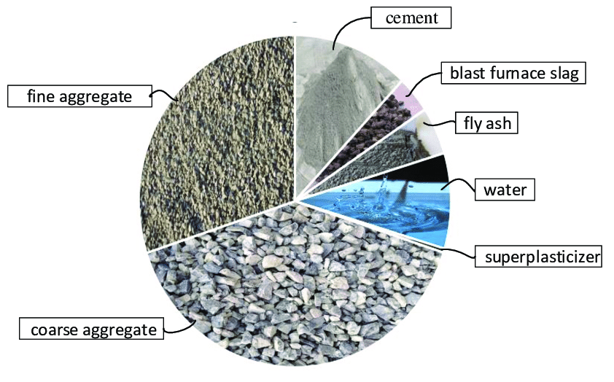
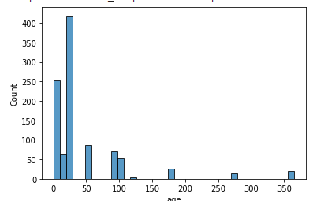
EXPLORING THE DATASET
INTERNET INFO

Slide 6
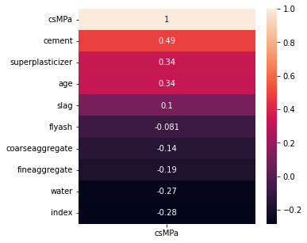
CORRELATION HEAT MAP

Slide 7
MODELS AND TECHNIQUES USED:
Linear Regression
Decision Tree
Random Forest
SVR
Grid search CV
Polynomial Regression

Slide 8
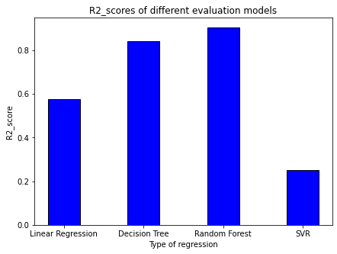
DIFFERENT ML MODELS

Slide 9
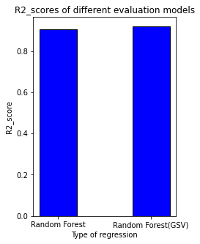

Slide 10
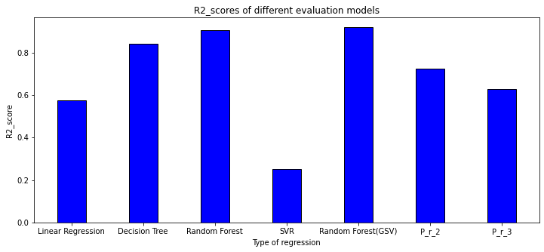

Slide 11
INSIGHTS
From the above graphs it is observed that:
Random Forest model is the best fit for this dataset as it is giving good accuracy.
The change in accuracy is very minute before and after applying Grid search cv to the Random forest model.
The accuracy of the models having polynomial degree as 2 and 3 is comparatively more than the accuracy of the linear regression(i.e) polynomial with degree 1.

Slide 12
CHALLENGES AND LEARNINGS
Time management
Model Selection
Understanding the new models such as SVM, Polynomial regression. Comparing models after implementing the techniques such as Grid search CV.

Slide 13
THANK YOU

